Slide 1

Spock presentation

Slide 2
Spock – but why?
Build in mechanism for mocking and stubbing
Leverages groovy syntax
Supports behavioral way of writing tests

Slide 3
Maven dependency (mandatory )
<!-- Mandatory dependencies for using Spock -->
<dependency>
<groupId>org.spockframework</groupId>
<artifactId>spock-core</artifactId>
<version>1.0-groovy-2.0</version>
<scope>test</scope>
</dependency>

Slide 4
Junit vs Spock
Junit | Spock
TestClass | Specification
@BeforeClass | setupSpec()
@AfterClass | cleanupSpec()
@Before | setup()
@After | cleanup()
Assertion | Condition is enough (e.g. value == true)
@Test | Method within Specification

Slide 5
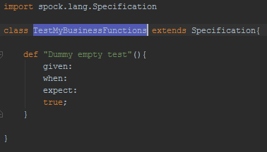
First Test

Slide 6
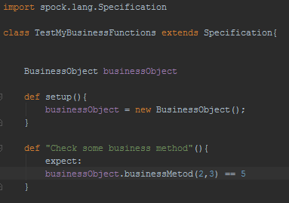
Second Test

Slide 7
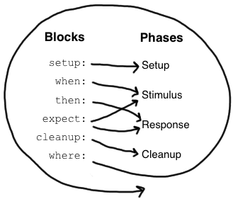
Blocks

Slide 8
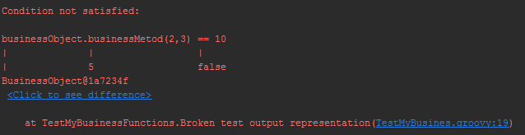
Test failed? See the output

Slide 9
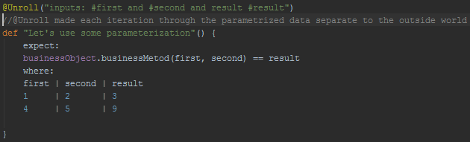
Parametrization rocks!!! Especially with @Unroll

Slide 10
Mocking
Mocking is the act of describing (mandatory) interactions between the object under specification and its collaborators.

Slide 11
Dependency
<dependency> <groupId>cglib</groupId> <artifactId>cglib-nodep</artifactId> <version>2.2.2</version> </dependency>

Slide 12
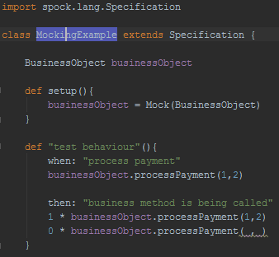
Example

Slide 13
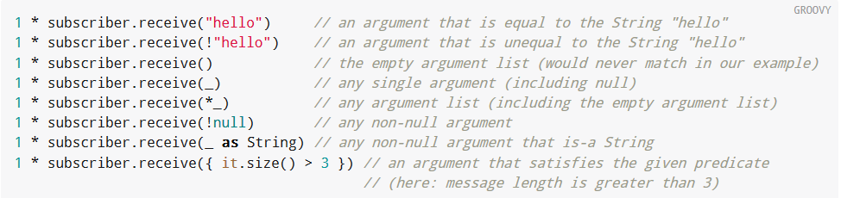
Argument Constraints

Slide 14
Stubbing
Stubbing is the act of making collaborators respond to method calls in a certain way. When stubbing a method, you don’t care if and how many times the method is going to be called; you just want it to return some value, or perform some side effect, whenever it gets called.

Slide 15
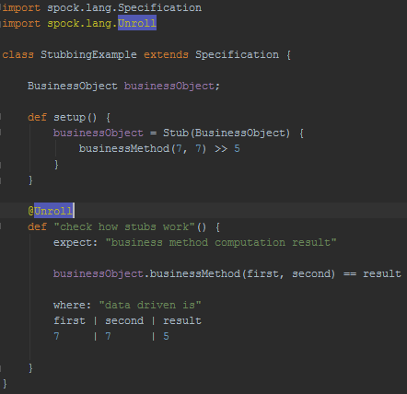
Example

Slide 16
Spock & Spring
<dependency>
<groupId>org.spockframework</groupId>
<artifactId>spock-spring</artifactId>
<version>0.7-groovy-2.0</version>
</dependency>

Slide 17
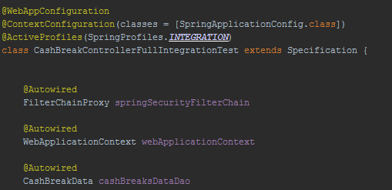
Example

Slide 18
Reference
https://github.com/spockframework
http://www.infoq.com/presentations/Spock
http://spockframework.github.io/spock/docs/1.0/index.html
https://github.com/tomkasp/spock-presentation

